Slide 1
Lending Club Case Study
By Jawad Sonalkar & Noushad Chono Kadavath

Slide 2
Goal
The aim is to identify patterns which indicate if a person is likely to default, which may be used for taking actions such as denying the loan, reducing the amount of loan, lending (to risky applicants) at a higher interest rate, etc by analysing the past loan applications.

Slide 3


1. Intro
In this case study, use EDA to understand how consumer attributes and loan attributes influence the tendency of default using the the data given which contains the information about past loan applicants and whether they ‘defaulted’ or not.
When a person applies for a loan, there are two types of decisions that could be taken by the company:
Loan accepted: If the company approves the loan, there are 3 possible scenarios described below:
Fully paid: Applicant has fully paid the loan.
Current: Applicant is in the process of paying the instalments
Charged-off: Applicant has not paid the instalments in due time.
Loan rejected: The company had rejected

Slide 4
Business Understanding
This company is the largest online loan marketplace, facilitating personal loans, business loans, and financing of medical procedures. Borrowers can easily access lower interest rate loans through a fast online interface. The credit loss is the amount of money lost by the lender when the borrower refuses to pay or runs away with the money owed. In other words, borrowers who default cause the largest amount of loss to the lenders. The company wants to understand the driving factors (or driver variables) behind loan default, i.e. the variables which are strong indicators of default
Tip
In this scenario, we’re working with the data provided.
Two types of risks are associated with the bank’s decision:
loss of business by rejecting the genuine applicant.
financial loss for the company by accepting wrong applicant.

Slide 5
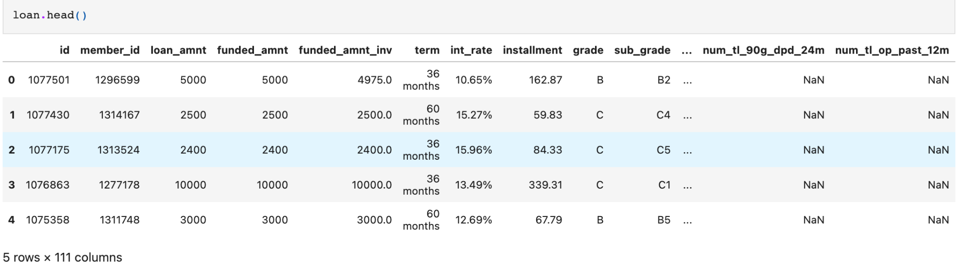
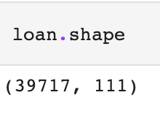
Data understanding
Tip
Identify the depth and nature of the dataset provided.
Used following Python modules to get these details.
pandas

Slide 6
Data cleaning
In this step we'll make the clean and make the data ready by considering following factors,
Remove invalid / irrelevant columns: As there are more than 100+ some columns ought to be irrelevant for our analysis, like columns which have all null values or columns which have a same value across all rows. We can remove these columns from the dataset
Fix rows: Remove duplicate rows or rows which is having a missing value for our key analysis field ie loan status or changing the dtypes
Removing columns with all null values
Removing columns with all same values
Removing columns with personal info field as we dont need personal info to take decision.
Removing columns based on business understanding like post charge collection_recovery_fee, recoveries etc
Removing current loan status as we are looking for fully paid vs Charged-off, current loan will not add any value, so lets remove those records
Tip
Go through the data and understand the nature and identify the details required and not required. When looking at the dataset we found out that there are some columns contains NA values like the very second column from data dictionary ie acc_open_past_24mths

Slide 7
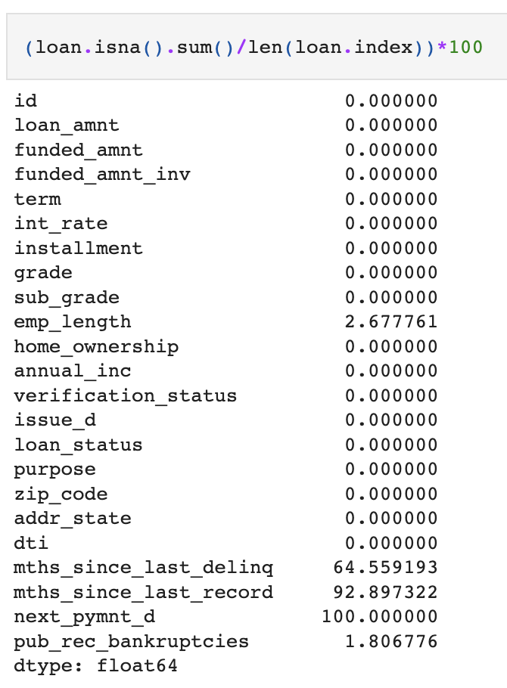
Handling missing Values
We can see columns like mths_since_last_delinq, mths_since_last_record and next_pymnt_d has more than 60% missing values. This will not add any benefits in our analysis, so lets drop the columns
Tip
For now lets leave all the missing values as it is

Slide 8
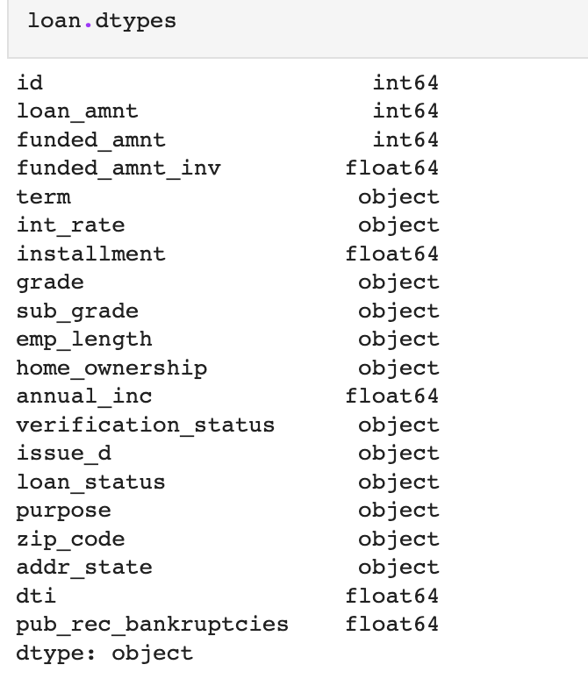
Standardise Values
In this section we'll try to standardise the values, like fix the dtypes
Tip
Here we can see the int_rate is of type object but its a quantitative variable, so lets convert the type by remove removing %

Slide 9
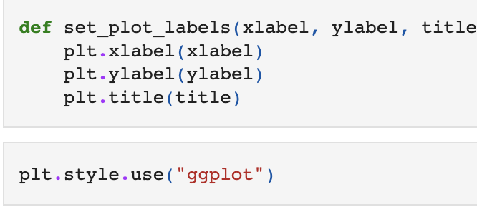
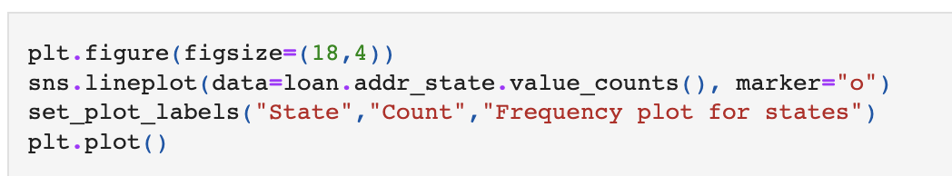
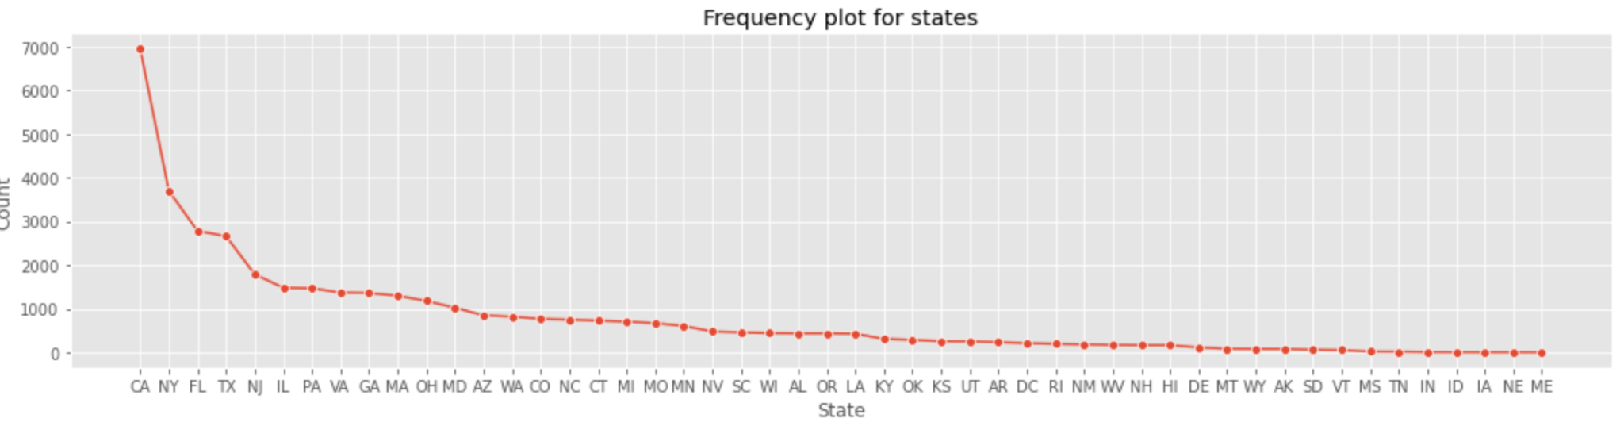
Data Analysing
Univariate
Let's perform univariate and do analysis of individual variable.
let's plot a frequency chart and see based on field addr_state which is an unordered variable.
In this section we'll try to understand different features and how these features are related to each other. We'll also find out which variable has the most impact on our target variable which is loan_status
Tip
We can see that the california has the highest borrower followed by New York.

Slide 10
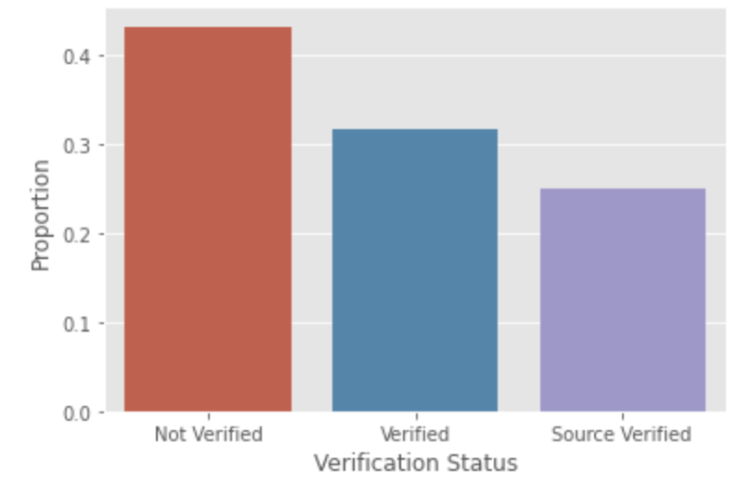
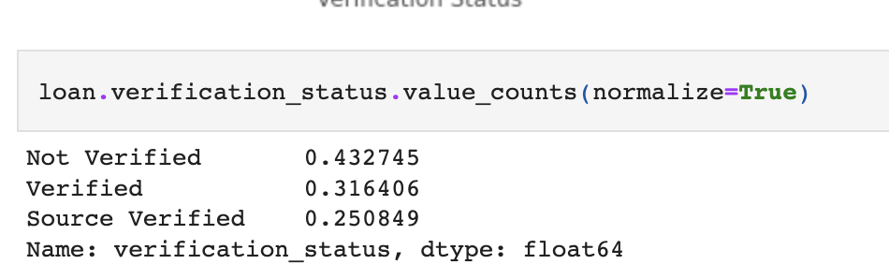
Data Analysing Cont…
Lets analyze few other variables
We can see the sum of Verified and source verified is coming to 56% and not verified is coming to 45%. Which is not really matching with 15% charged off, that means the unverified borrowed are not necessarily charging off

Slide 11
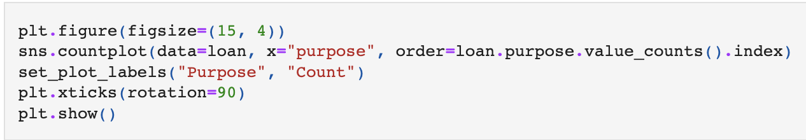
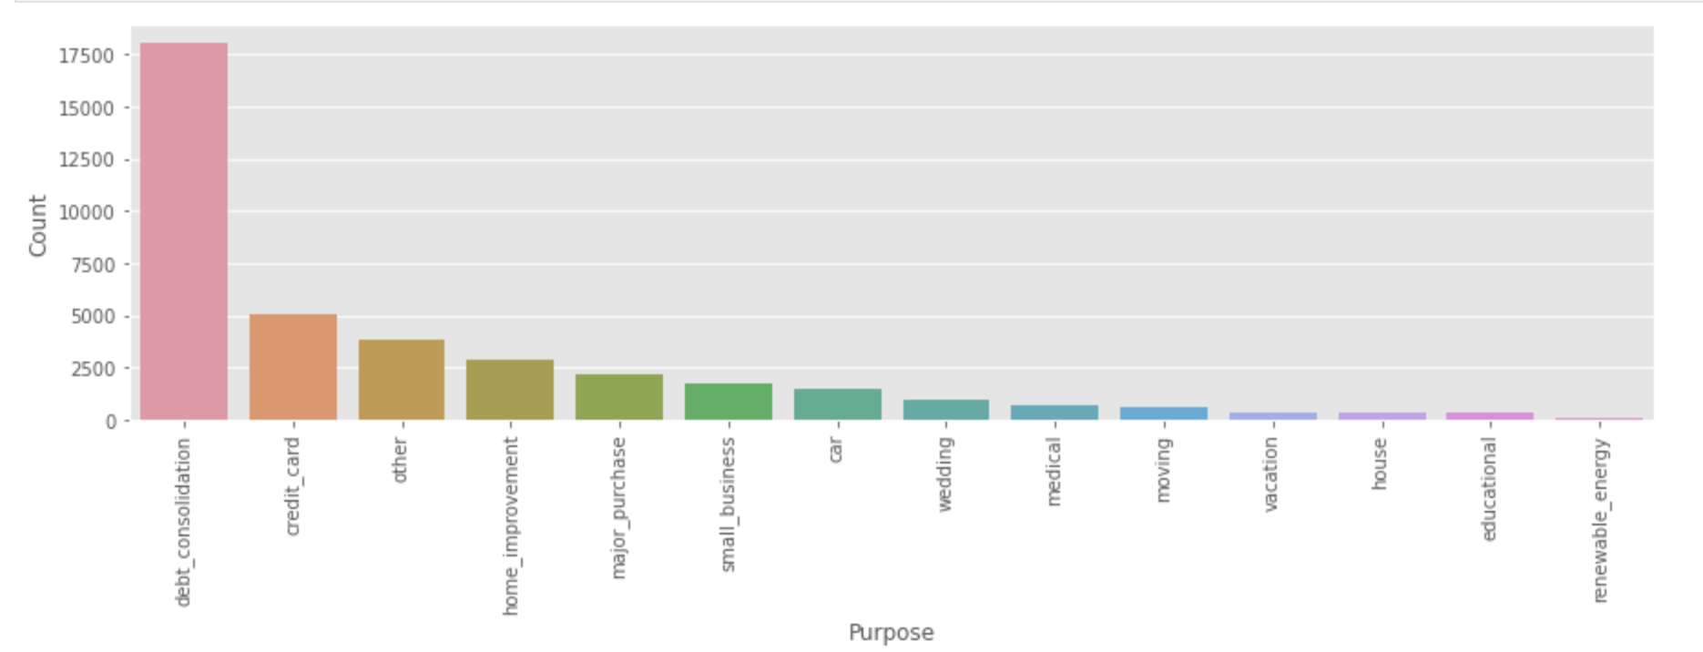
Data Analysing Cont…
More deeper analysis..
Looks like most of them are taking loan for Debt Consolidation

Slide 12
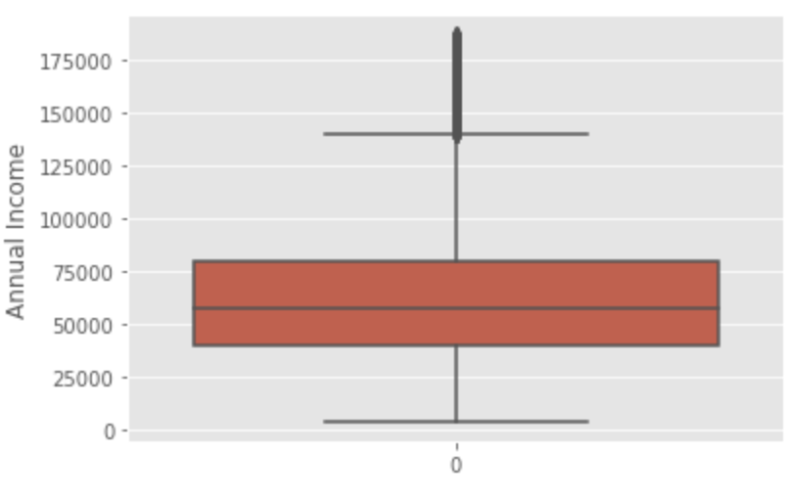
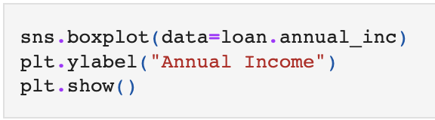
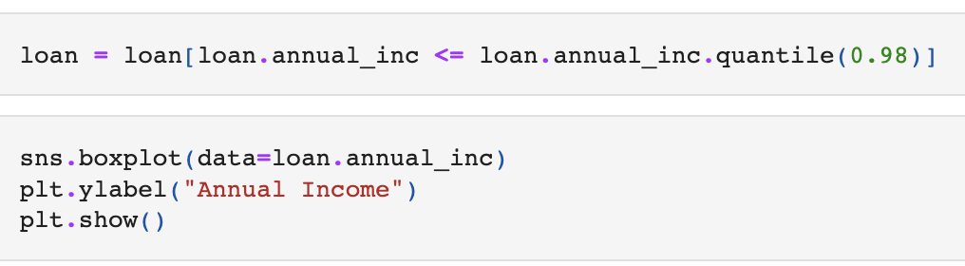
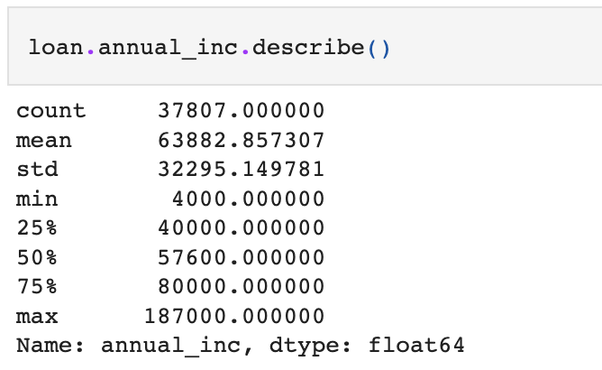
Data Analysing Cont…
Let's have a look at some quantitative variables like annual Income based chart.
We can see the mean annual income for the borrower are around 60,000

Slide 13
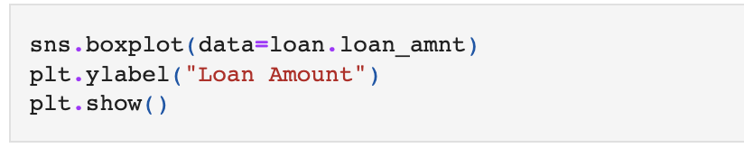
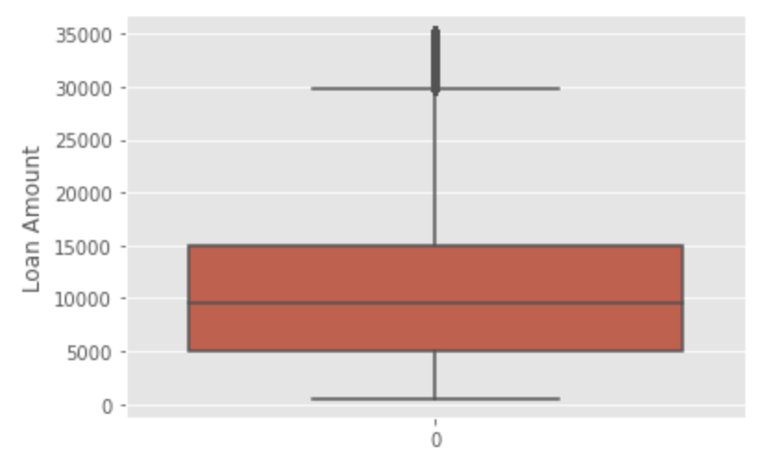
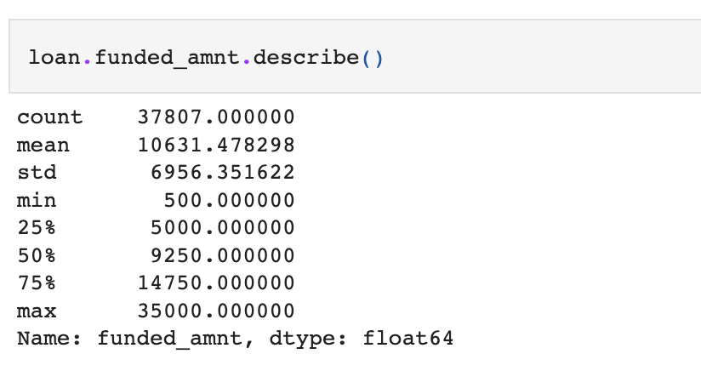
Data Analysing Cont…
Let’s have a look at the loan amount disbursed.
Average amount received to borrower is around 10,000

Slide 14
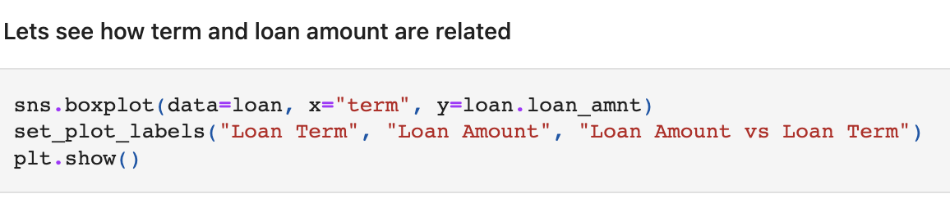
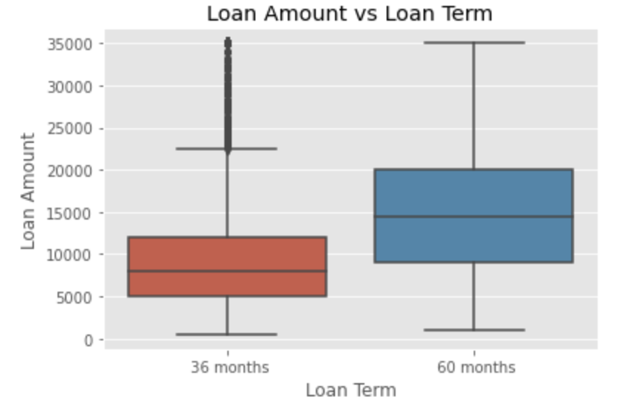
Multivariate Analysis.
Let's have a look at segmented and multivariate analysis to see a pattern
Here we can see that the Loan amount is more for higher term loan which make sense

Slide 15
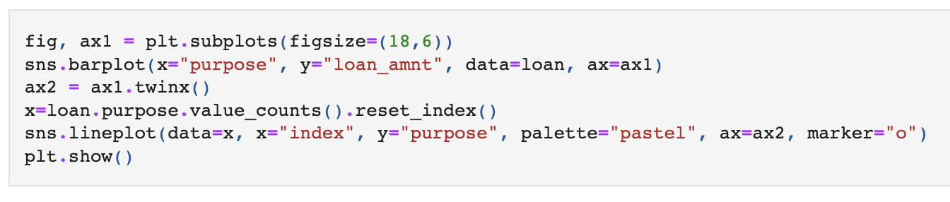
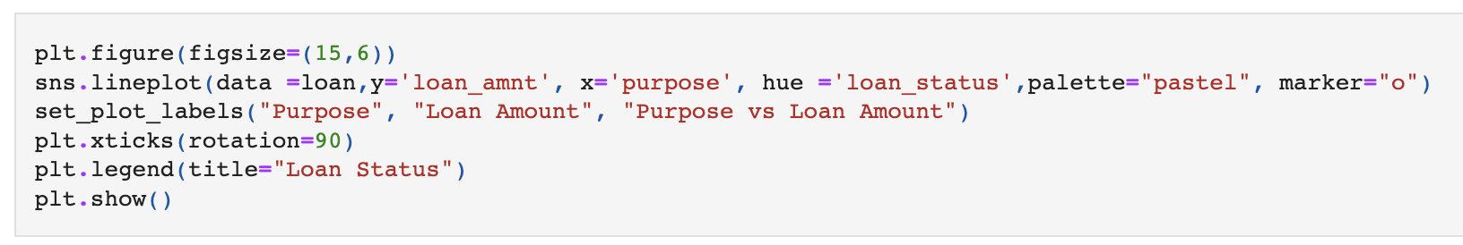
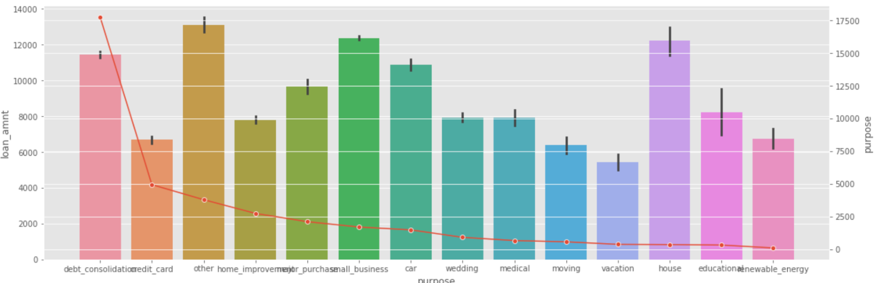
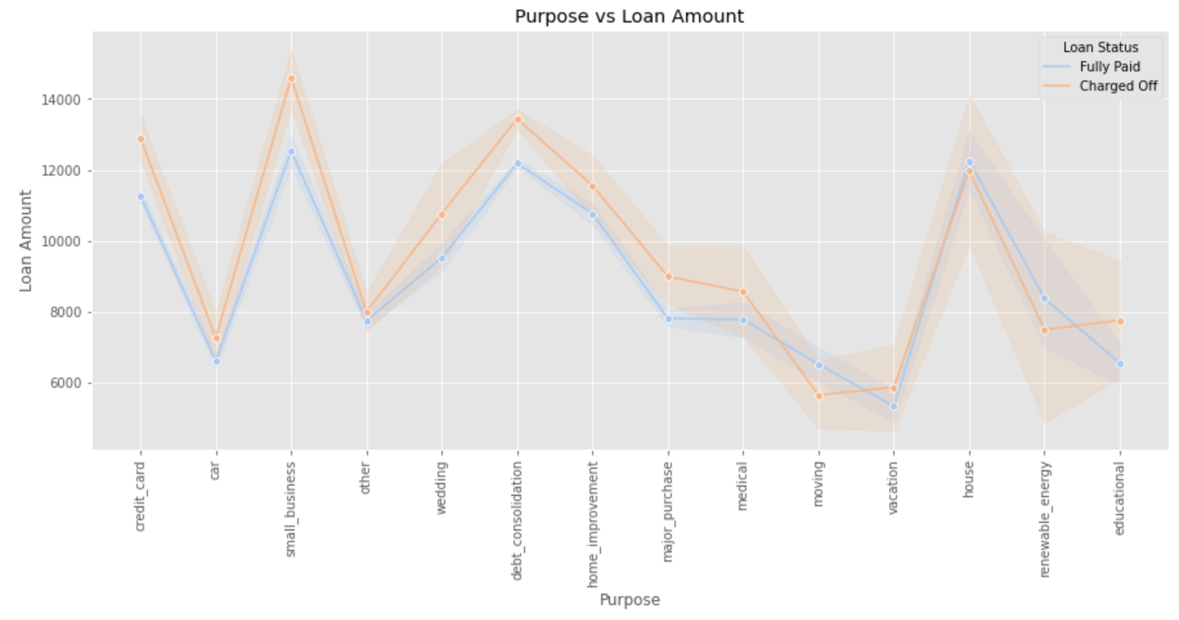
Multivariate Analysis.
Let's have a look at segmented and multivariate analysis to see a pattern
The number of loans for debt consolidation are higher plus the loan amount is also in the higher range so Higher loan amount is likely to charge of especially in case of small business and debt consolidation.

Slide 16
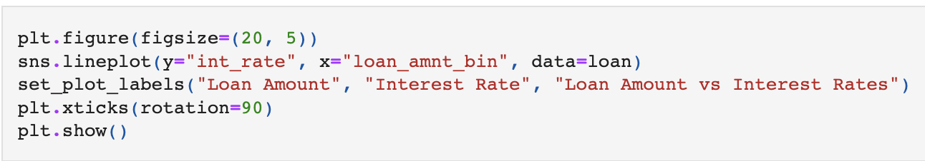
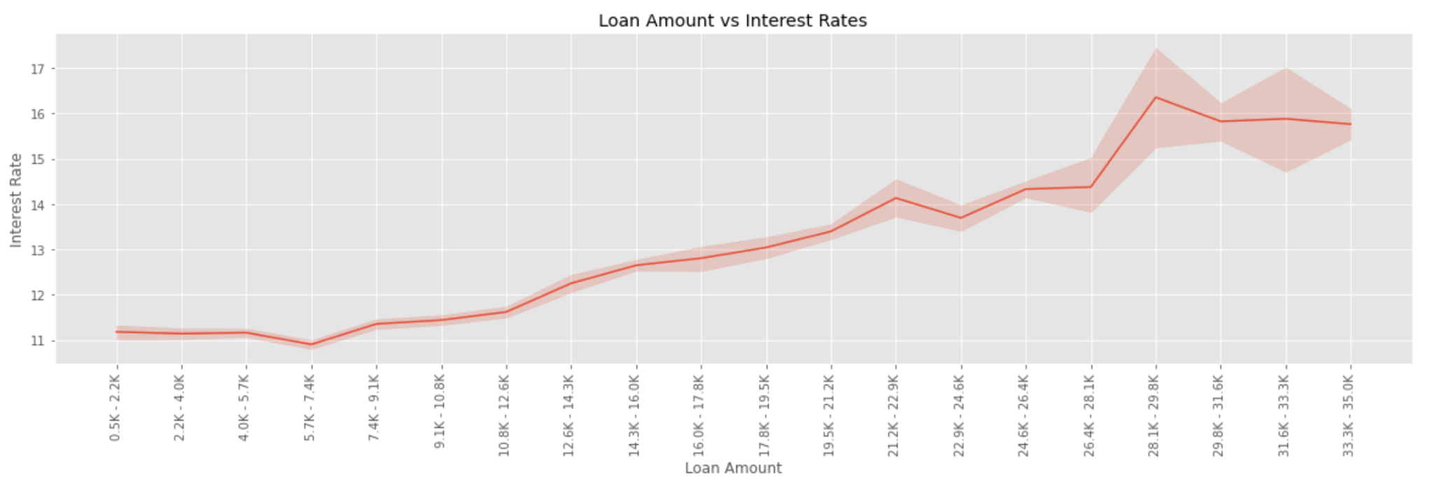
More Analysis.
Lets see how loan amount and interest rate are related
We can see increase in loan amount increase interest rate

Slide 17
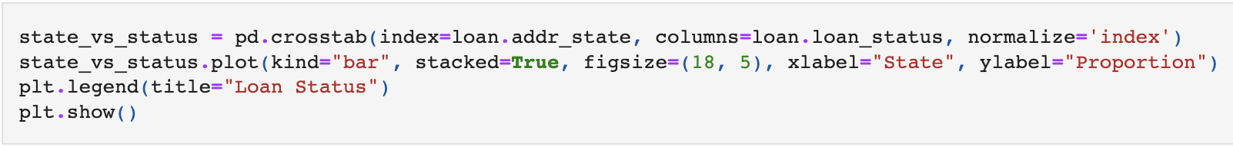
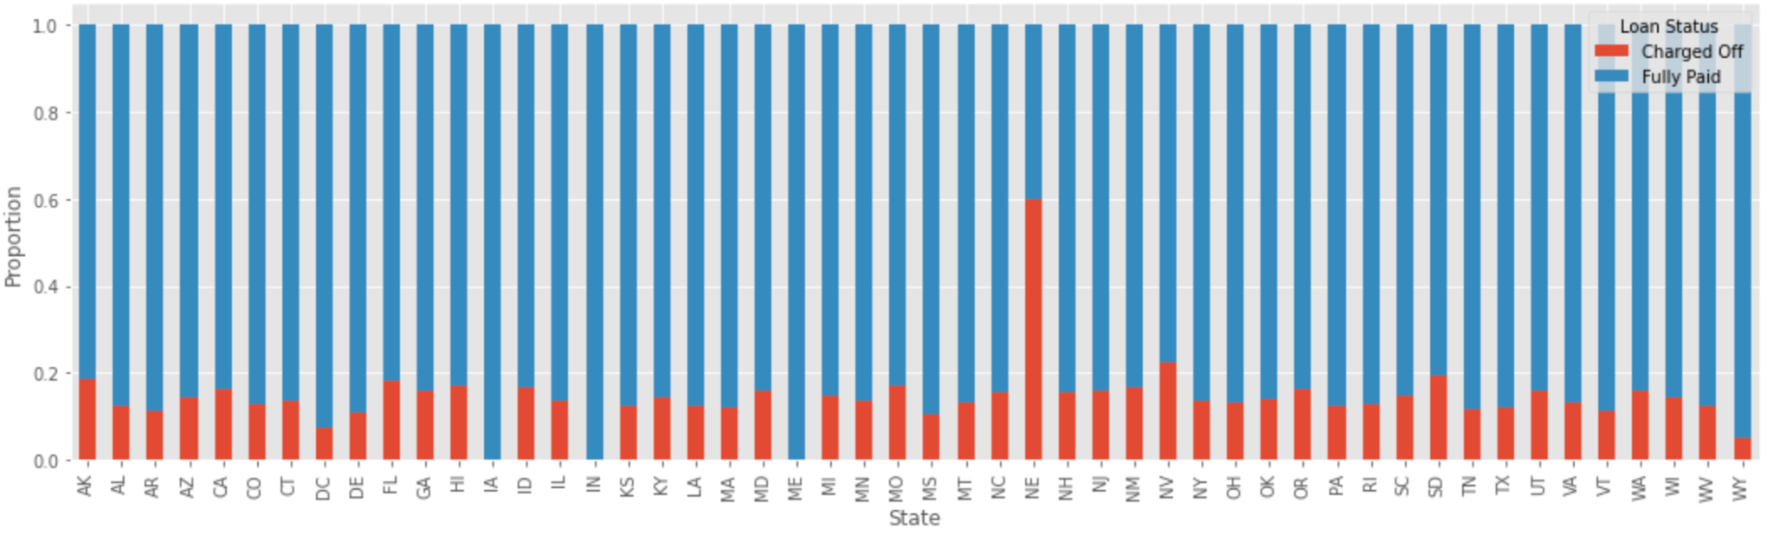
More Analysis.
Lets see state wise loan status
Althought proportion wise the state of NE has charged off the most, the count of the borrowers in NE is the least, so this value can be ignored so the state of the borrower does not influence the charge off.

Slide 18
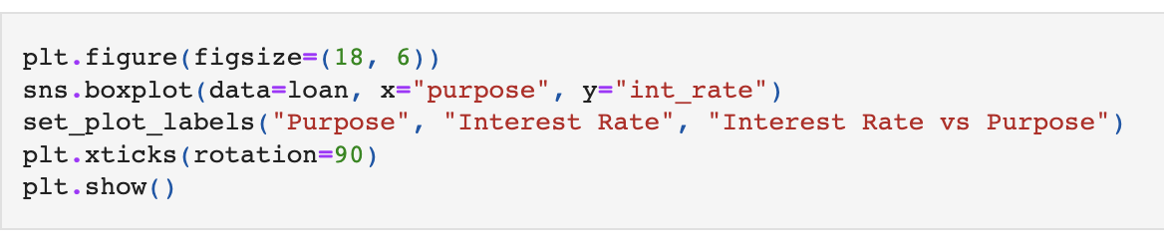
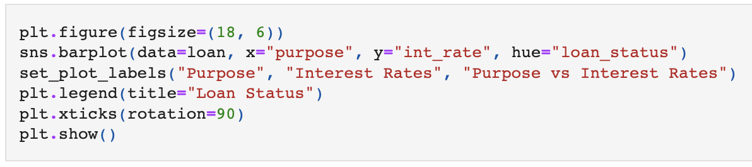
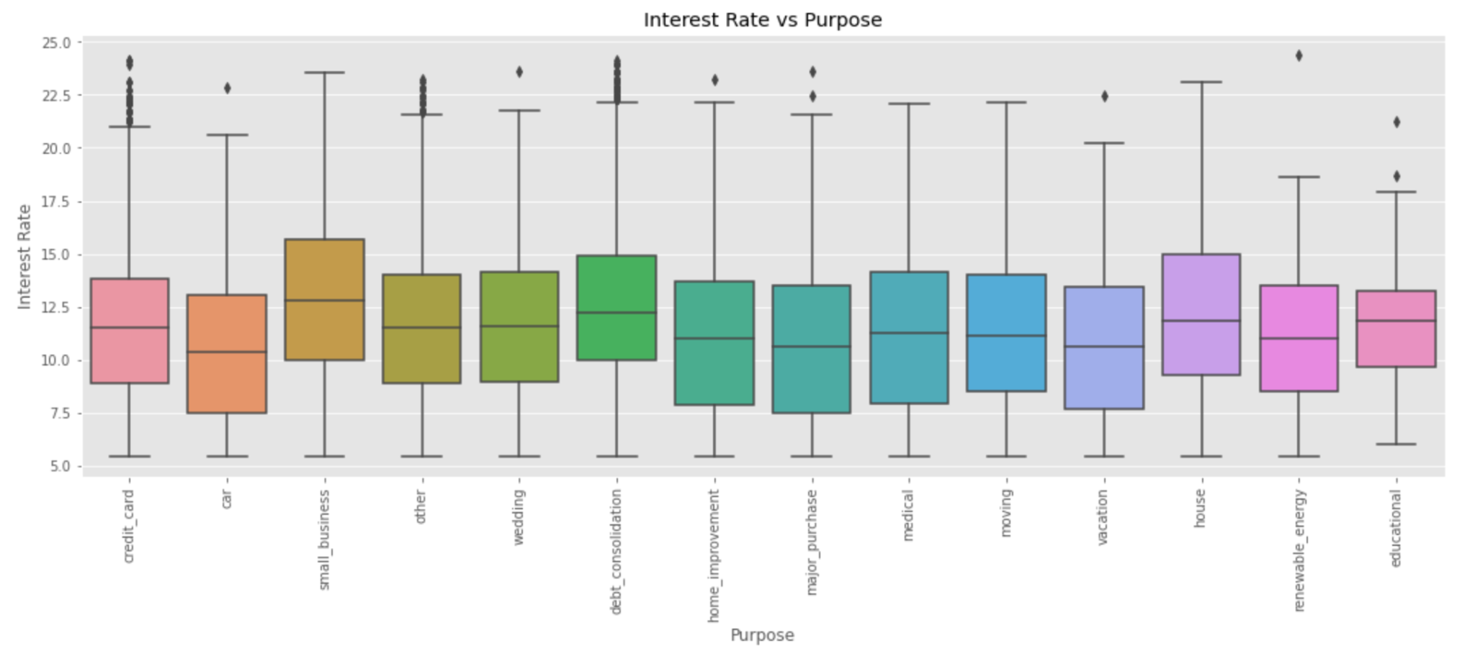
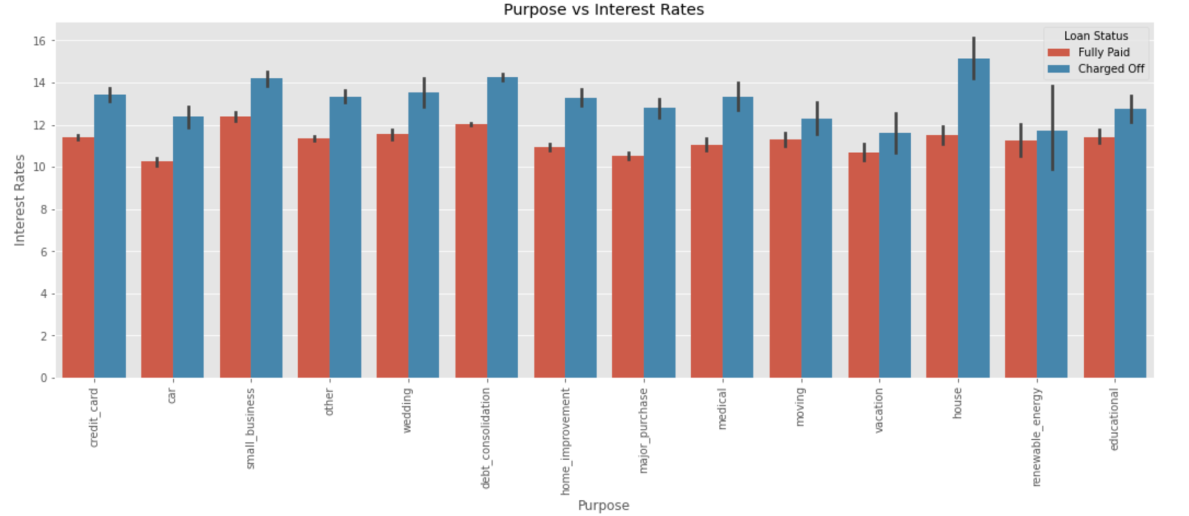
More Analysis.
Let's analys interest rate against purpose of the loan
Although the average rate of interest for small_business is higher, when we drill down we realize that the average int_rate are higher in house category for those who charged off if a housing category is having higher rate of interest the borrower will likely charge off

Slide 19
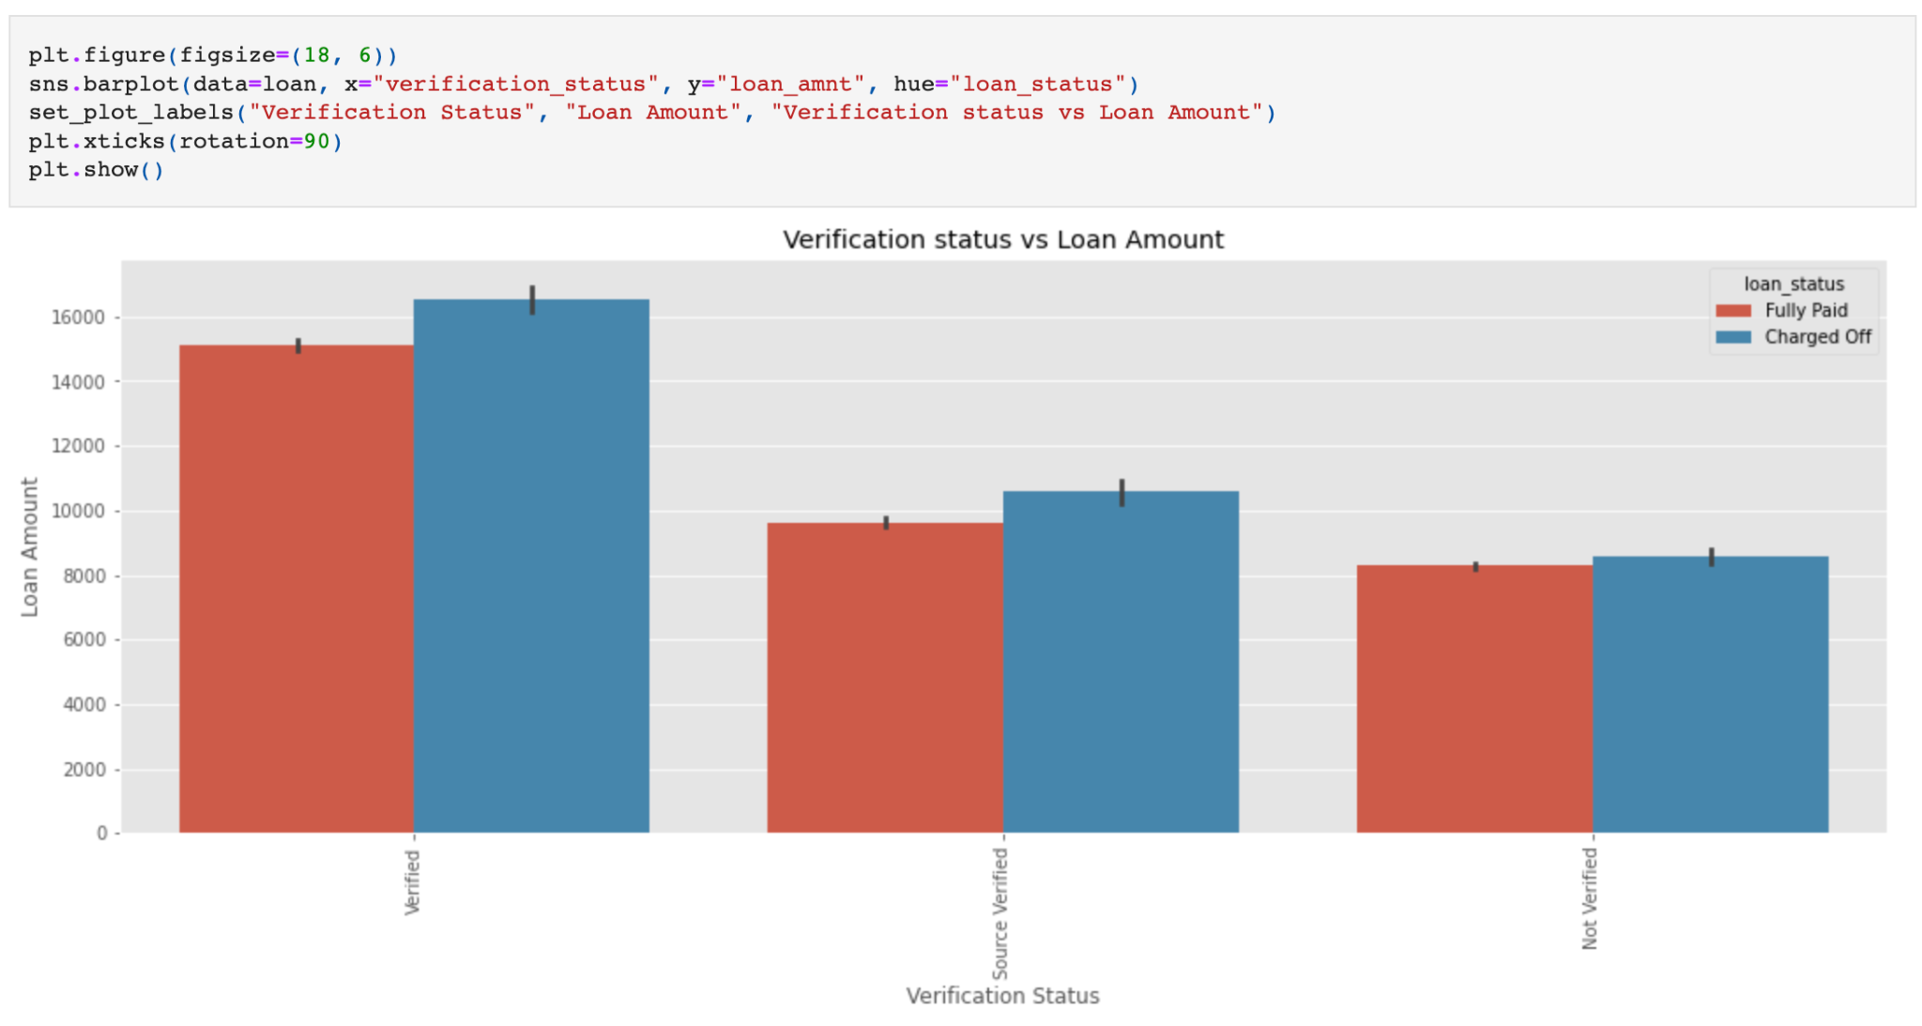
More Analysis.
Let's have a look at how the verification status and loan amount is related to charge off
On an average if a loan amount is higher borrower is likely to charge-off, it does not depend whether borrower is verified or not

Slide 20
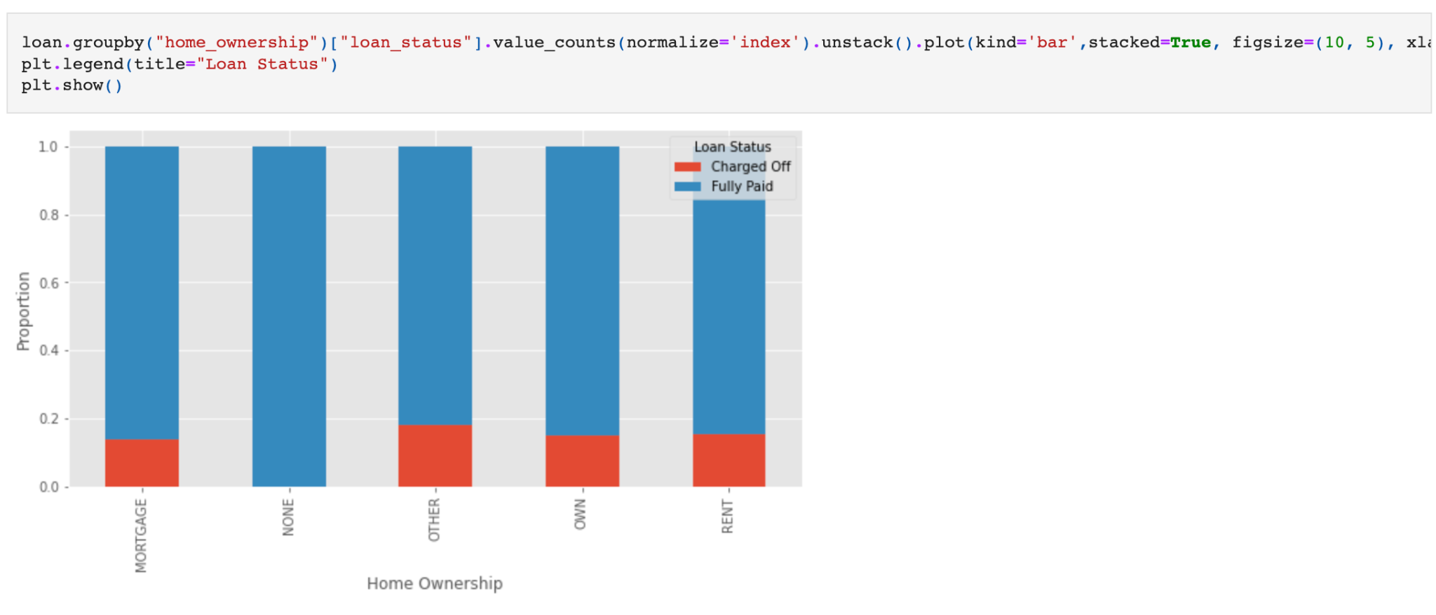
More Analysis.
Let's have a look how home_ownership are dependent on loan status
There seems to be no correlation between home_ownership and charge-offs

Slide 21
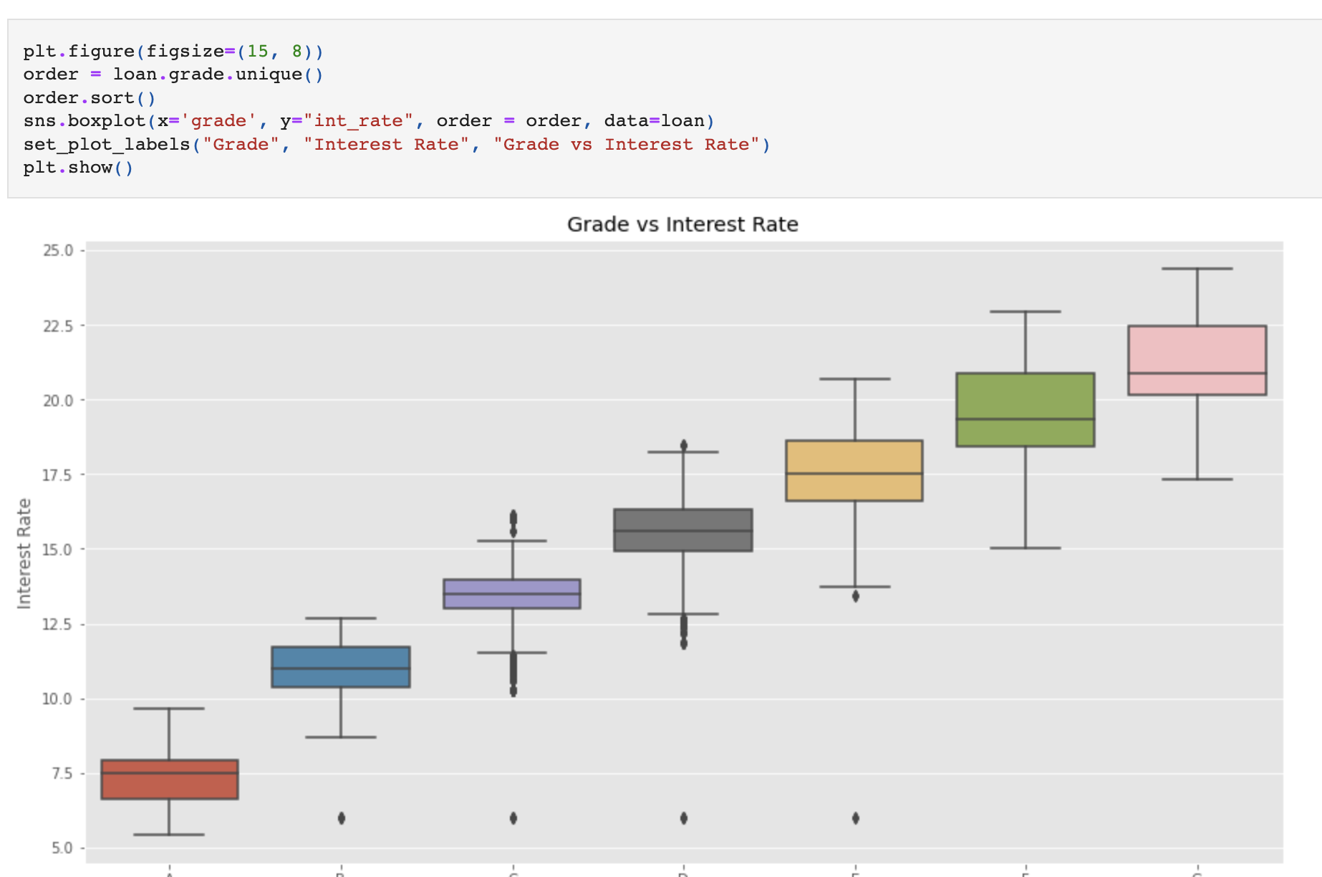
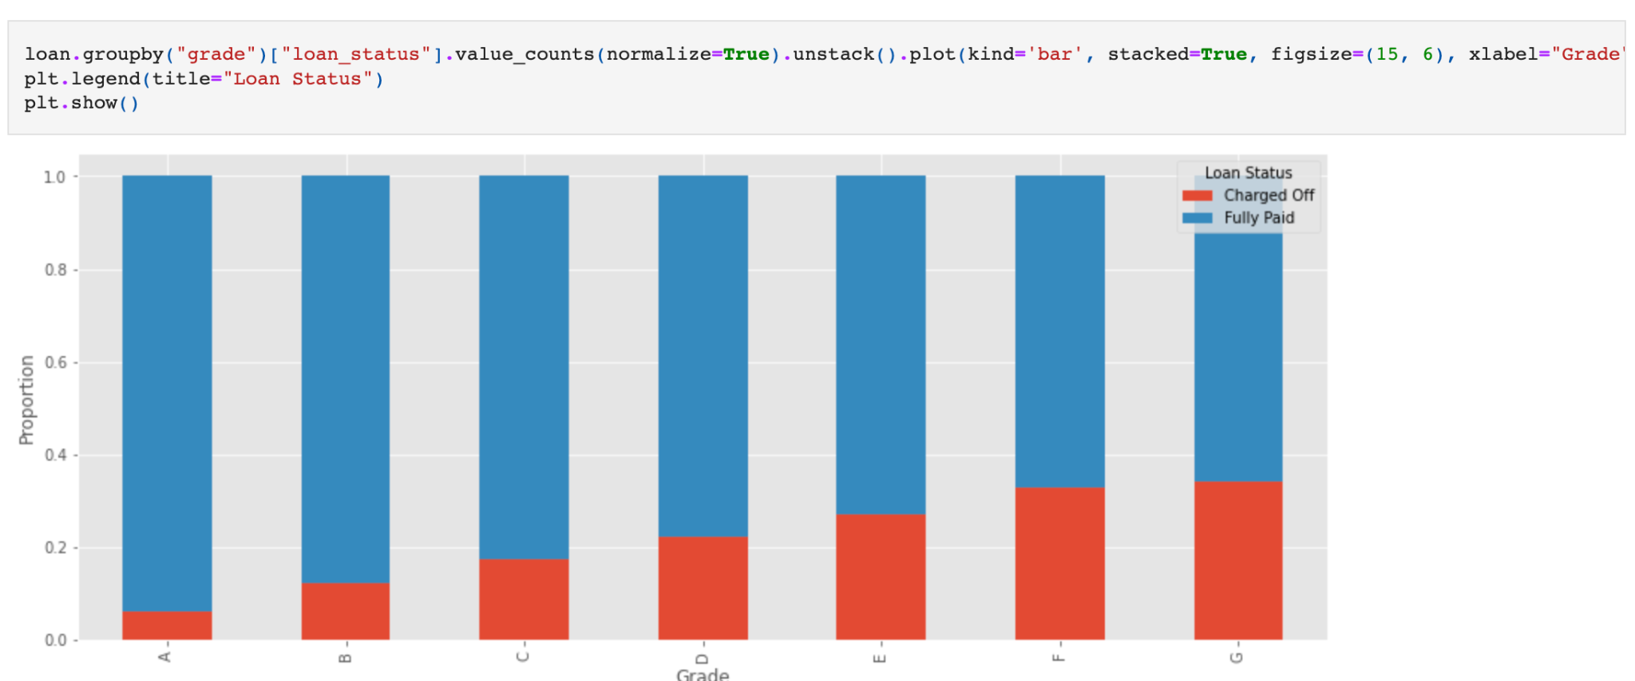
More Analysis.
Let’s analys how Grade influence interest rate
Loan with Lower grades generally has higher loan amount and are more likely to charge off

Slide 22
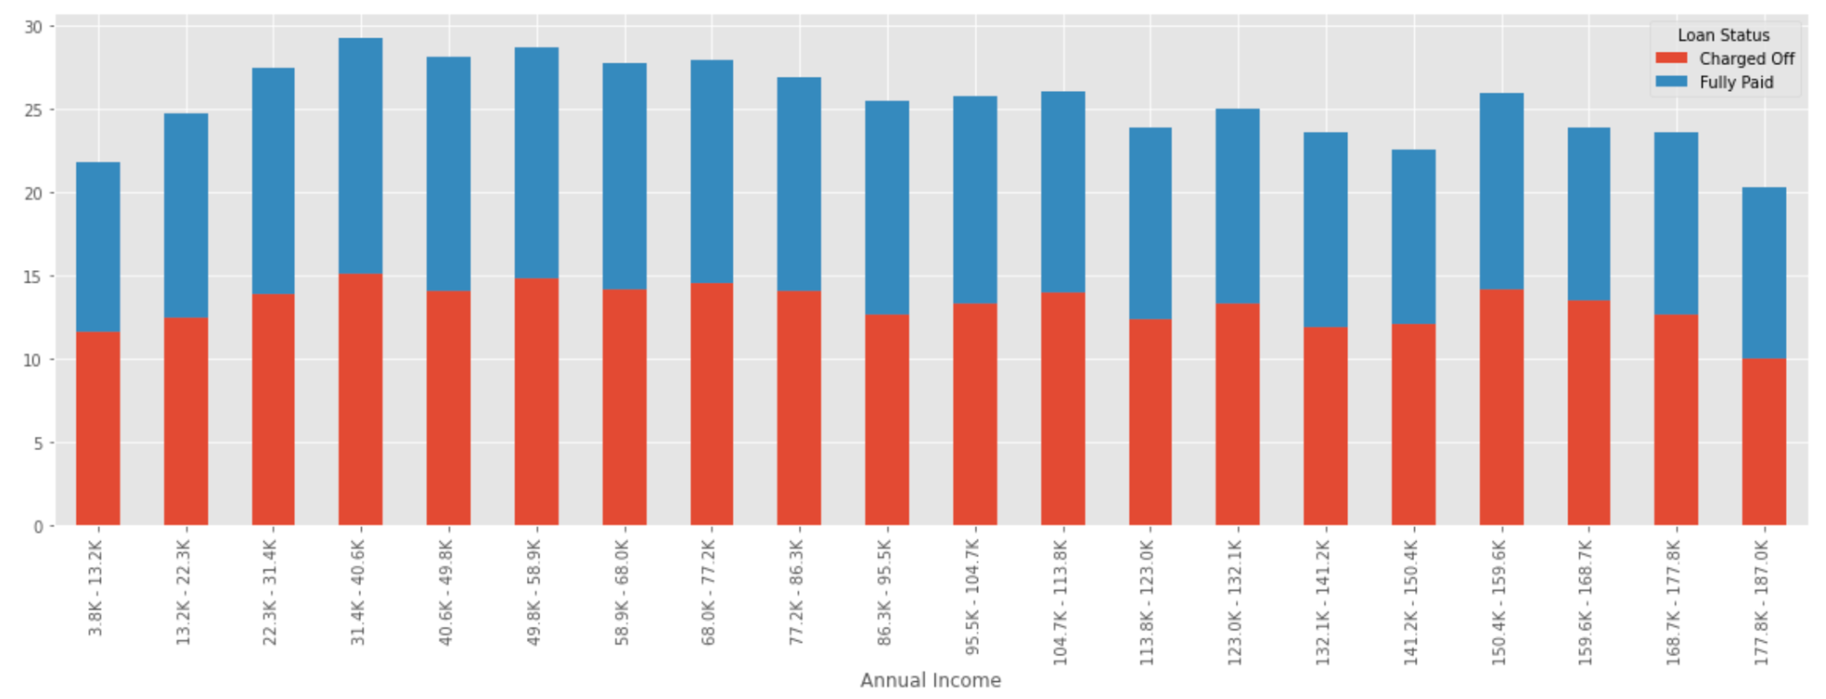
More Analysis.
Lets analyze influence of annual income and DTI
Borrowers with the annual income ranges from 31k to 40k have higher DTI rates and are like to charge off more

Slide 23
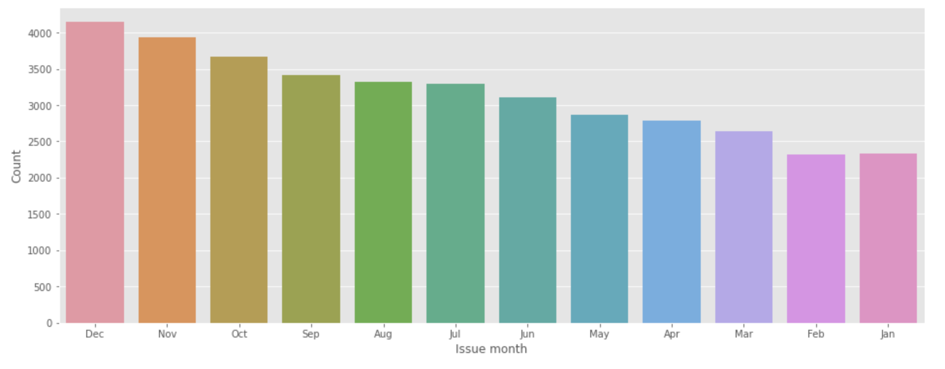
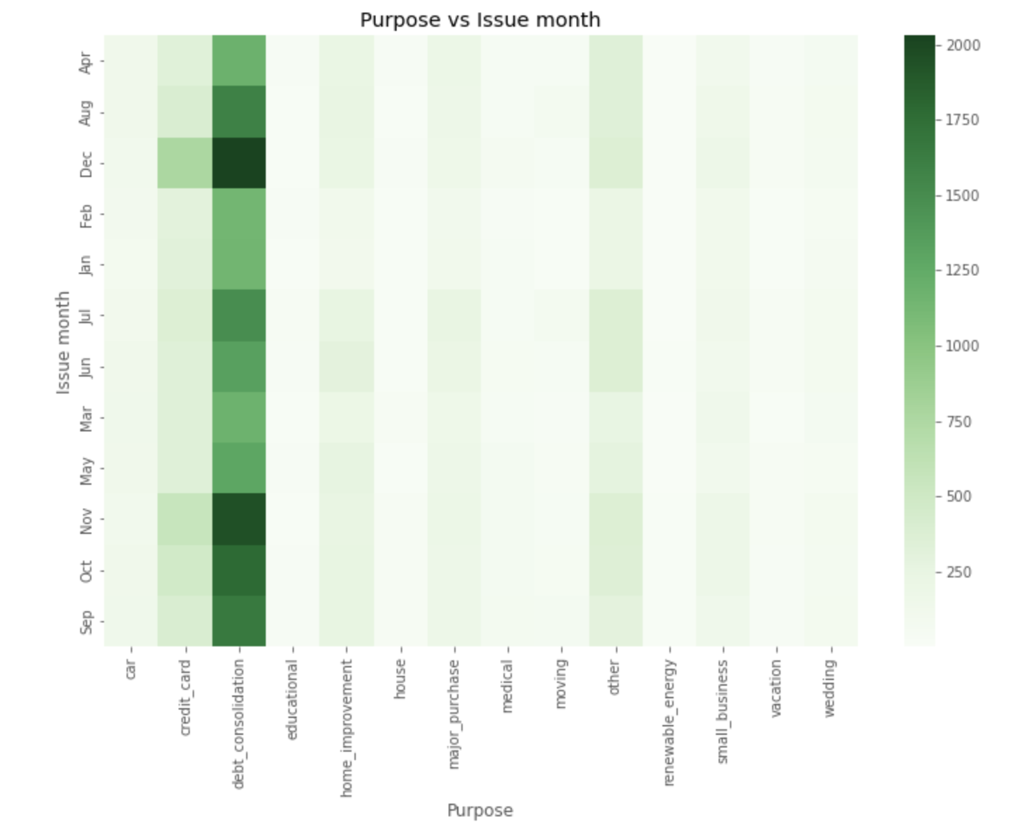
More Analysis.
Let’s understand the trend in each month
We can see in the month of Dec more loan is being taken, Here we can see that in month of Aug, Sept, Oct Nov, Dec borrowers are taking loan for debt_consolidation

Slide 24
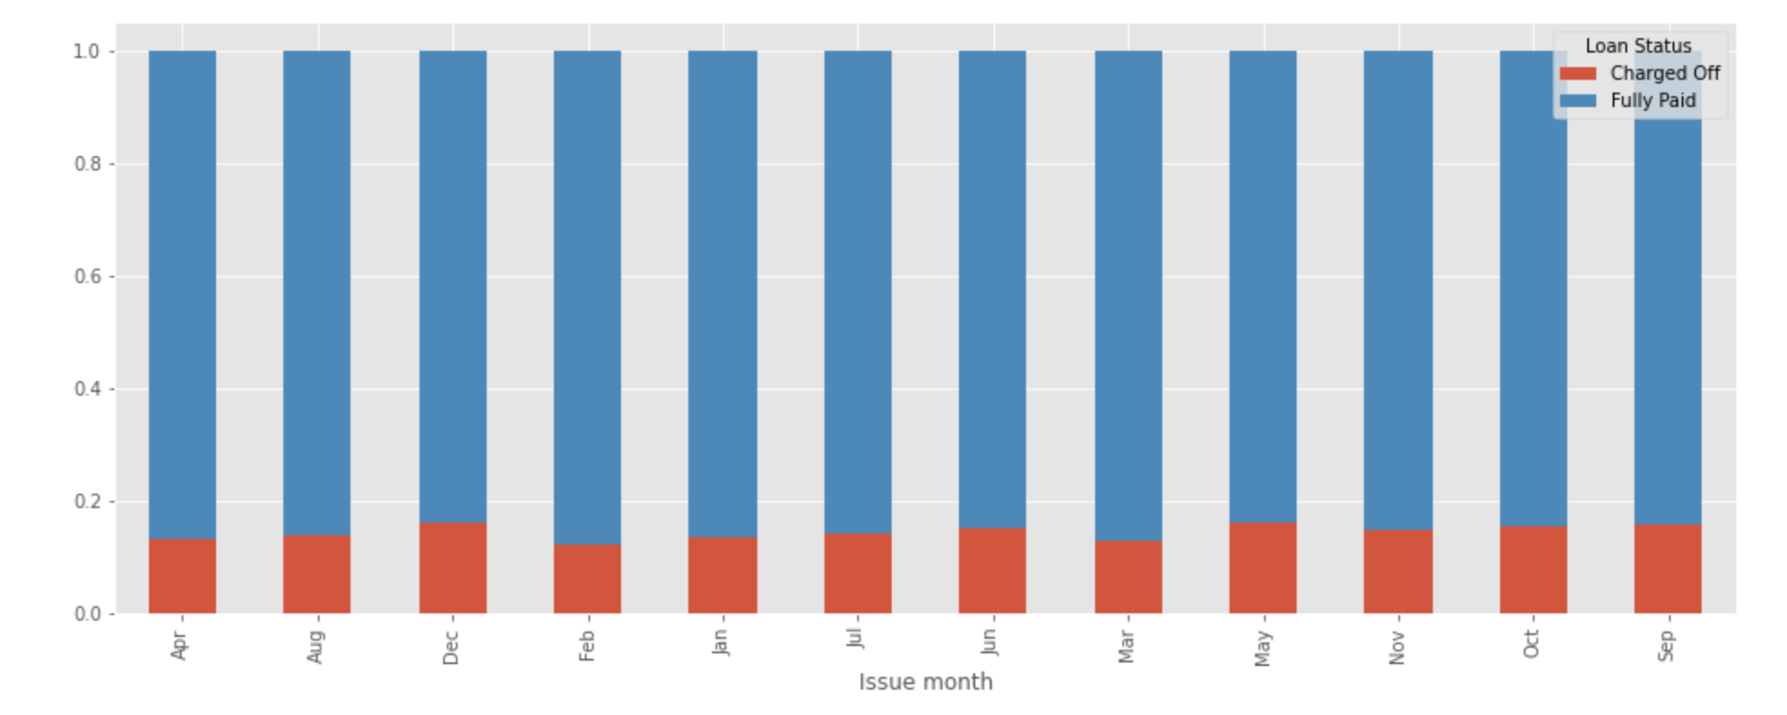
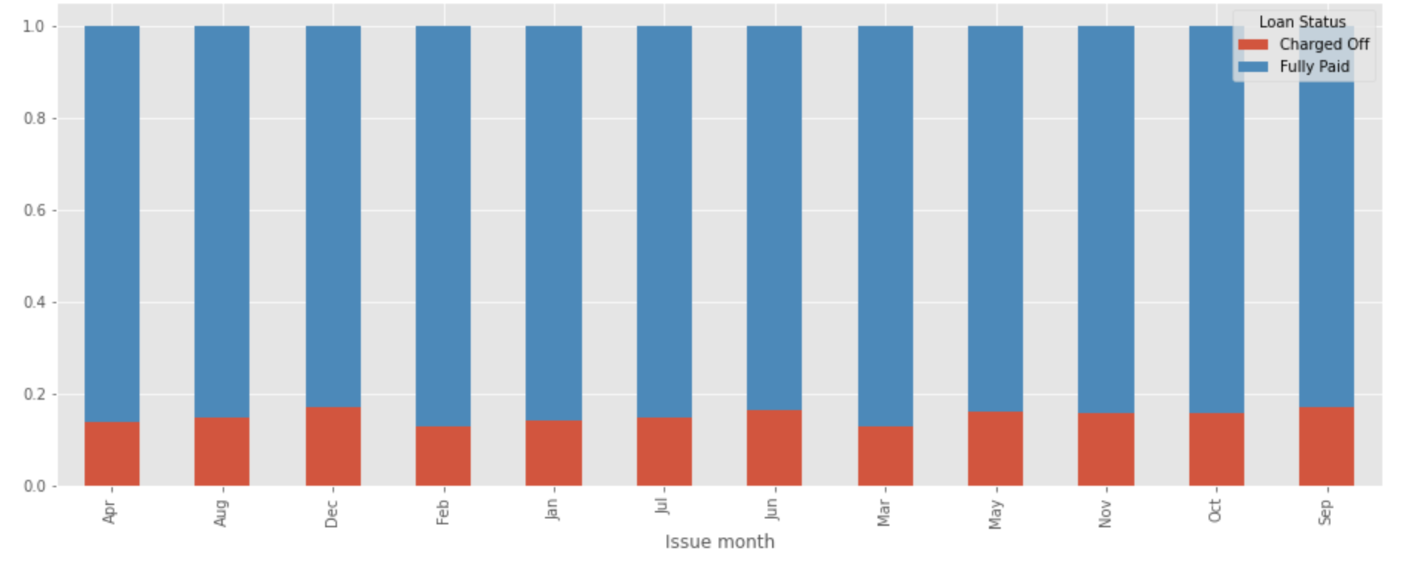
More Analysis.
Let’s understand the trend in each month
In month of Dec overall charge off is not significant,There's no significant increase in charge off to debt_consolidation in the last quarter

Slide 25
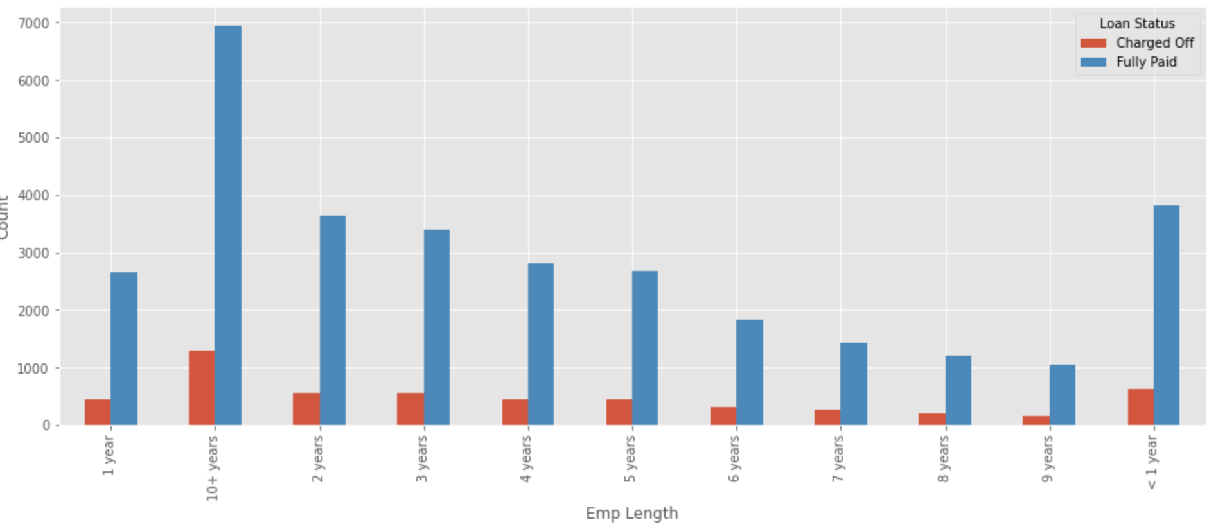
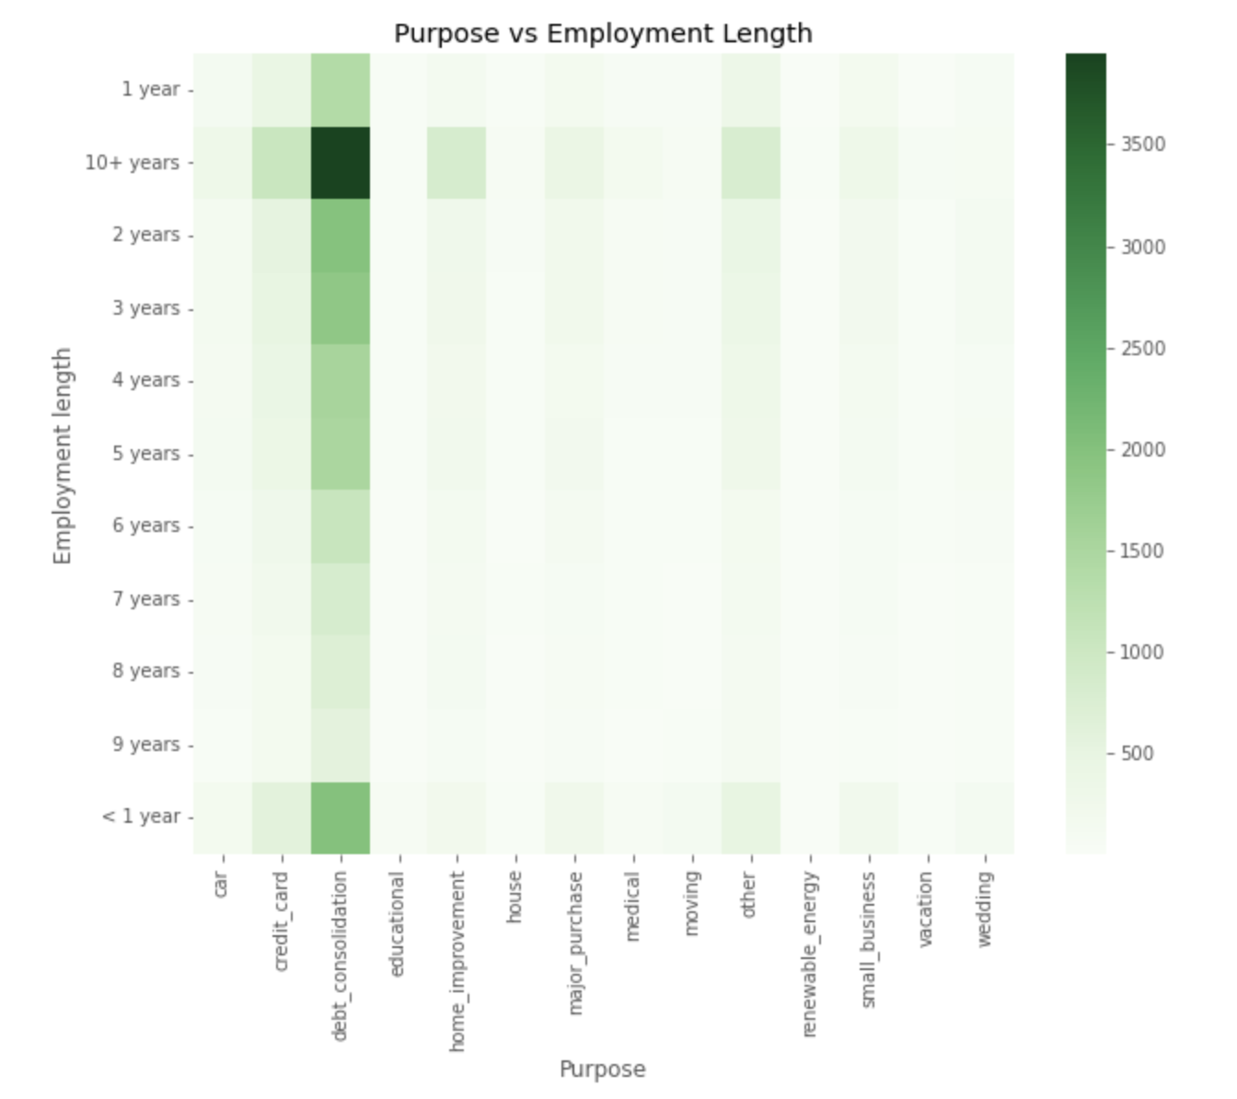
More Analysis.
Employee Length based analysis
Employees having exp greater than 10 year is borrowing the most and mainly for debt_consolidation

Slide 26
Observation and recommendation
Overall 15% of the borrower charges-off
State of california has the highest borrower number. But overall charge-offs are independent of the state of the borrower. Although the state of Nebraska has higher percent of charge-off the number of borrowers are also very less, so it can be considered consequential
Most of the loans are taken for Debt Consolidation. Loan taken for debt consolidation and small businesses with higher loan amount are likely to charge off
Whether the source is verified or not it does not really impact the charge-offs
If a loan amount is higher the term is also more and there is a likely of charge-off
Most of the loans are taken in the month of Oct, Nov and Dec again mainly for Debt Consolidation, but there is no unusal increase in charge during this period for Debt Consolidation purpose

Slide 27
Observation and recommendation
If a borrower is taking a loan for housing and rate of interest is higher then the borrower is likely to charge-off
Average annual income of the borrowers are around 60k. Borrower with annual income ranges from 30k to 40k have higher DTI and are more likely to charge-off
Verification status of the borrower does not guarantee that there will be no charge-offs
The rate of interest increases with the loan amount
Interest rates are higher for small business.
Loan with Lower grades generally has higher loan amount and are more likely to charge off
Employees having exp greater than 10 year is borrowing the most and mainly for debt_consolidation
Loan amount requested are based on annual income which make sense

Slide 28
Thank You !

